Slide 1
ECE158A: Computer Networks
Tara Javidi
Lectures: TTH 5:00-5:30pm Center Hall 222
TAs: Mohammad Ahmadypour
Topic 1
Introduction and Overview

Slide 2
I am grateful to many authors/instructors around the country who have shared their educational material on this topic freely available online to everyone including me and my students. In particular, the content of these slides is heavily adapted from the educational resources that are made available by Pearsons authors:
Kuros & Ross and Tannenbaum & Weatherall (if you sign in you can see the slides and a whole lot more) in conjunction with the course material of Professor Jennifer Rexford at Princeton. Note that as such the content of these slides is subject to the copyright of the above authors and instructors.

Slide 3
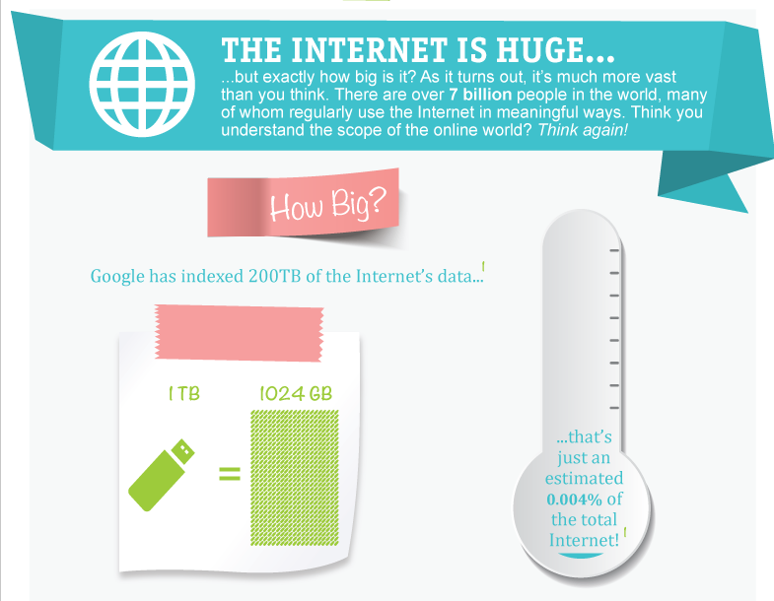

Slide 4


Slide 5
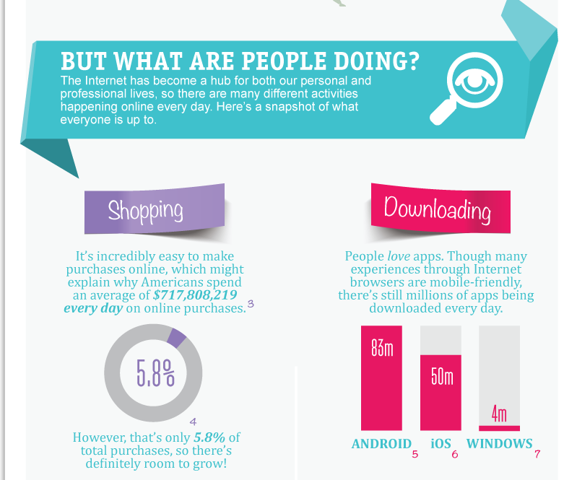


Slide 6
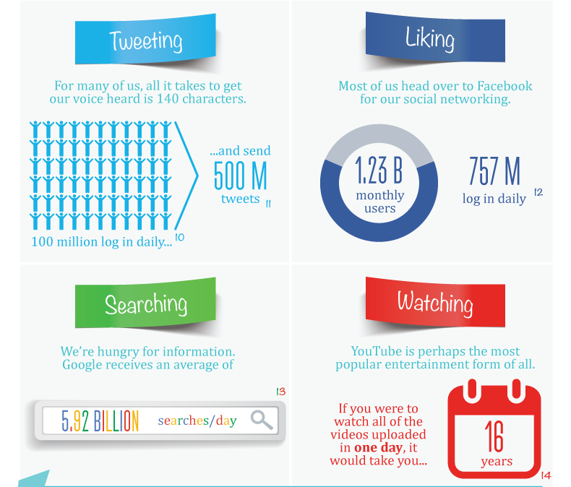

Slide 7
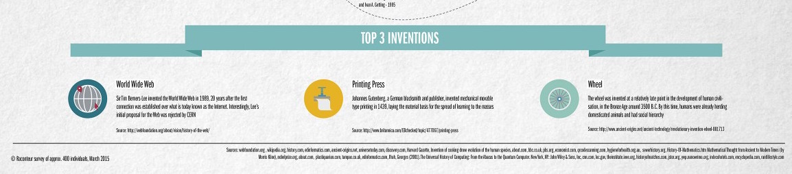
Website Raconteur asked over 400 scientists, tech journalists, academics, authors and interested readers to name the greatest inventions of all time.

Slide 8
What are the design principles that made this possible? How applicable are these to other networks such as sensor nets, IoTs, smart meters, etc?

Slide 9
Course Organization

Slide 10
Learning Objectives
Engineering principles of network design
Network architecture: Internet as an example
Simple mathematical analytic tools
Statistical multiplexing, shortest path routing, fairness resource allocation and congestion control
Network emulations/sims (assignments only)
Precise network analysis not possible due to scale
Simulations and emulations are used instead
Assignments are there for you to get familiar (not enough time/resource to build expertise☹)

Slide 11
Textbooks
No required book
Books on reserve
Communication Networks: A Concise Introduction, Jean Walrand and Shyam Parekh
Computer Networking: A Top-Down Approach Featuring the Internet, by Kurose and Ross
Computer Networks, by Tanenbaum

Slide 12
Grading
4 assignments (44% total; 11% each)
95% < 5 hours, 70% <1 days late, 50% < 2 days late
Two exams (54% total)
Midterm on October 27th (23%)
Final exam during exam period (31%)
Class participation (2%)
Pre-lecture Readings
In lecture and discussion and on Piazza

Slide 13
Policies: Submit Your Own Work
Learning and creativity in an individual process. While thinking about a problem, discussions with friends are encouraged. However, when the time comes to write your HW or your code for your project, the work must be entirely yours.
If you have a question about the HWs and projects, you can certainly ask your friends or the TA, but do not, under any circumstances, copy another person's work.
Letting someone copy your work or using someone else's work in any form is a violation of academic integrity.

Slide 14
What is the Internet?

Slide 15
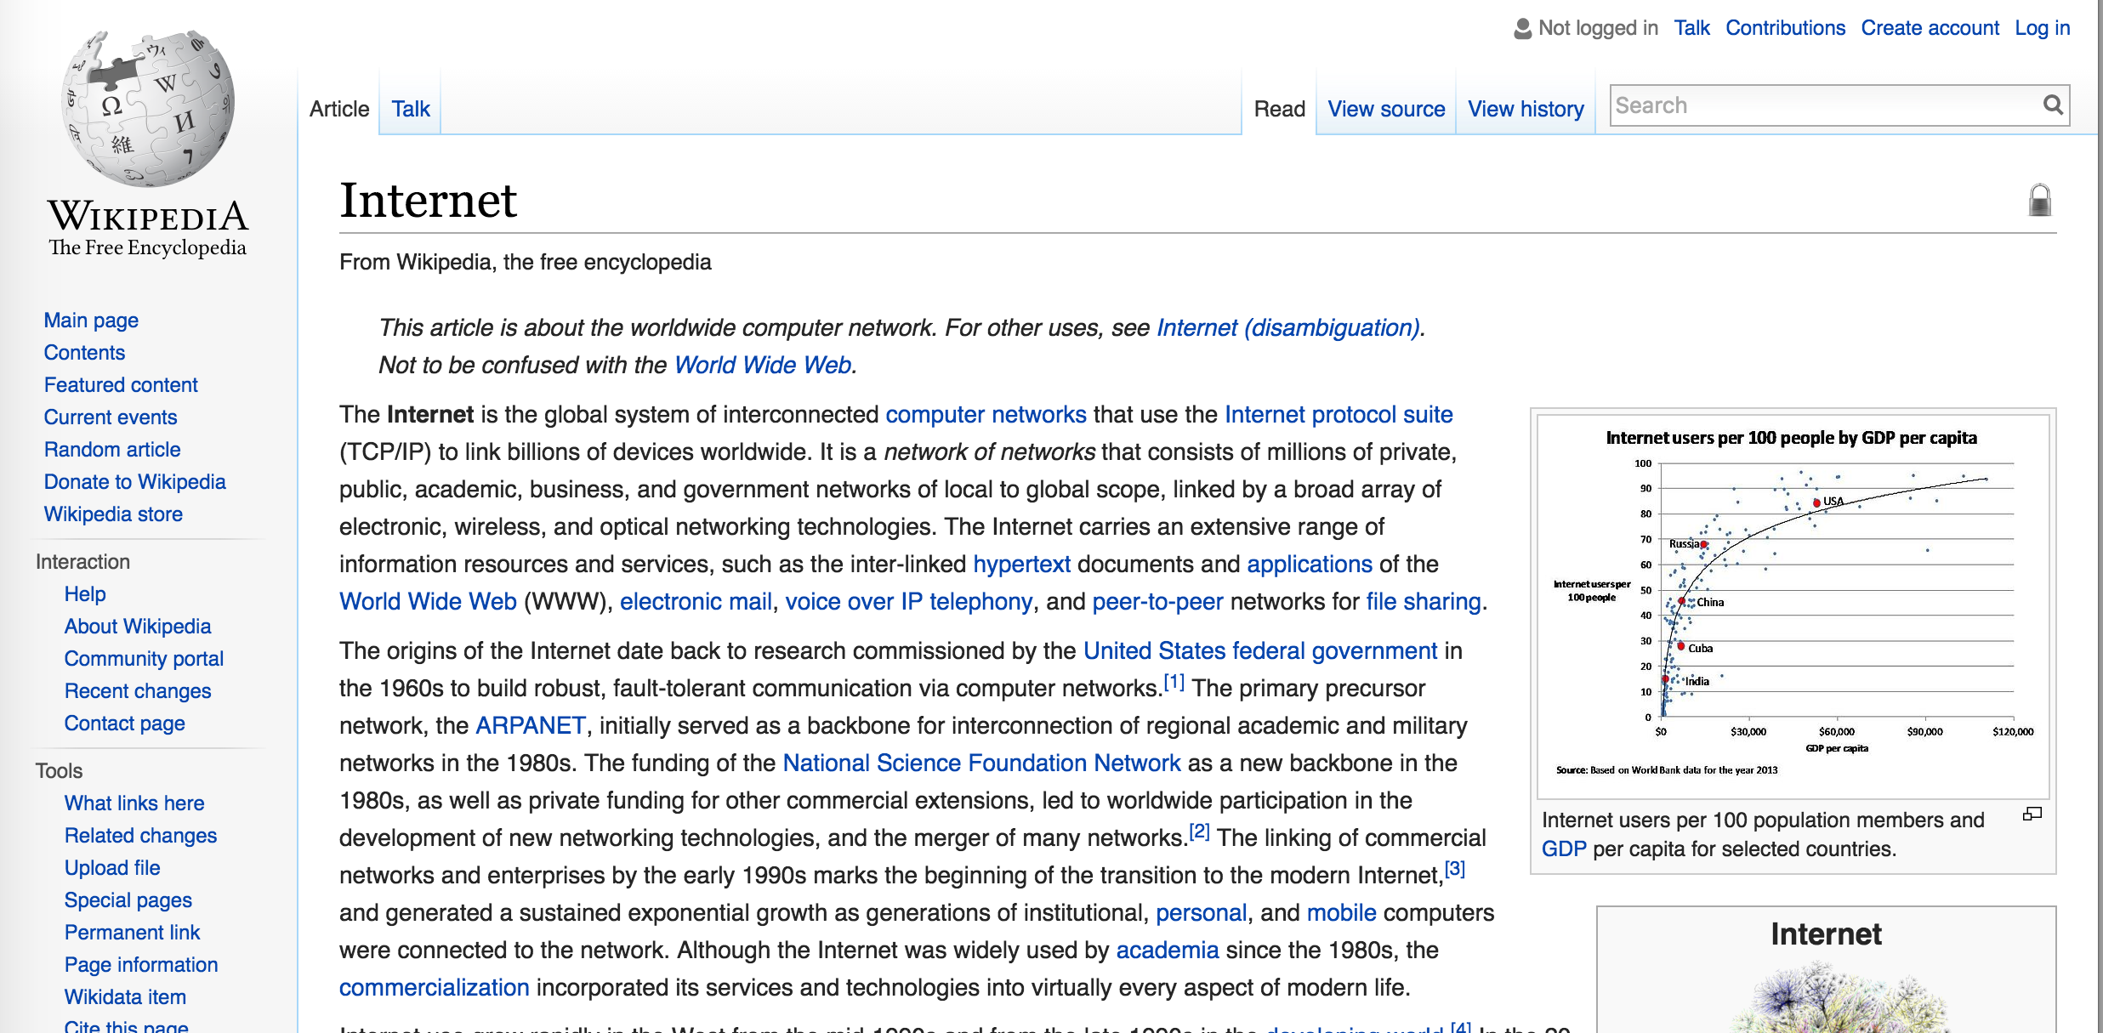
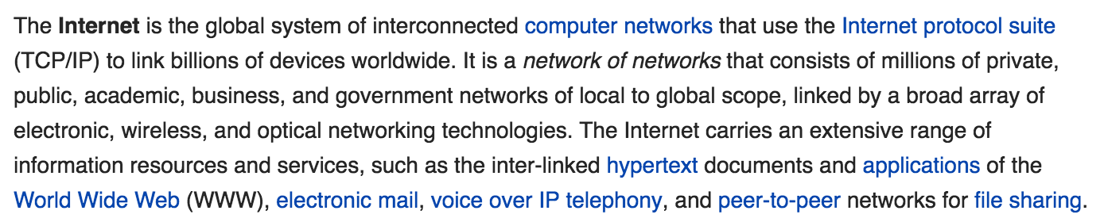
What is the Internet?
http://en.wikipedia.org/wiki/Internet

Slide 16
Internet structure: network of networks
Question: given millions of access ISPs, how to connect them together?
…
…
access
net
access
net
access
net
access
net
access
net
access
net
access
net
…
…
access
net
access
net
access
net
access
net
access
net
access
net
…
access
net
access
net
…
access
net

Slide 17
Internet structure: network of networks
Option: connect each access ISP to every other access ISP?
…
…
access
net
access
net
access
net
access
net
access
net
…
…
access
net
access
net
…
connecting each access ISP to each other directly doesn’t scale: O(N²) connections.
…
…
access
net
access
net
…
access
net
access
net
access
net
…
access
net
…
access
net
access
net
…
access
net

Slide 18
Internet structure: network of networks
Option: connect each access ISP to one global transit ISP?
Customer and provider ISPs have economic agreement.
…
…
access
net
access
net
access
net
access
net
access
net
access
net
access
net
…
…
global ISP
access
net
access
net
access
net
access
net
access
net
access
net
…
access
net
access
net
…
access
net

Slide 19
Internet structure: network of networks
But if one global ISP is viable business, there will be competitors ….
…
…
access
net
access
net
access
net
access
net
access
net
access
net
ISP A
access
net
…
…
access
net
ISP B
access
net
ISP C
access
net
access
net
access
net
access
net
…
access
net
access
net
…
access
net

Slide 20
Internet structure: network of networks
But if one global ISP is viable business, there will be competitors …. which must be interconnected
Internet exchange point
…
…
access
net
access
net
access
net
access
net
access
net
IXP
access
net
access
net
ISP A
…
…
access
net
IXP
ISP B
access
net
ISP C
access
net
access
net
peering link
access
net
access
net
…
access
net
access
net
…
access
net

Slide 21
Internet structure: network of networks
… and regional networks may arise to connect access nets to ISPs
…
…
access
net
access
net
access
net
access
net
access
net
IXP
access
net
access
net
ISP A
…
…
access
net
IXP
ISP B
access
net
ISP C
access
net
access
net
access
net
regional net
access
net
…
access
net
access
net
…
access
net

Slide 22
Internet structure: network of networks
… and content provider networks (e.g., Google, Microsoft, Akamai) may run their own network to bring services/content close to edges
…
…
access
net
access
net
access
net
access
net
access
net
IXP
access
net
access
net
ISP A
…
…
Content provider network
access
net
IXP
ISP B
access
net
ISP C
access
net
access
net
access
net
regional net
access
net
…
access
net
access
net
…
access
net

Slide 23




















What is the Internet: “nuts and bolts” view
PC
billions of connected computing devices:
hosts = end systems
running network apps
mobile network
server
wireless
laptop
global ISP
smartphone
home
network
communication links
fiber, copper, radio, satellite
transmission rate: bandwidth
regional ISP
wireless
links
wired
links
packet switches: forward packets (chunks of data)
routers and switches
router
institutional
network
Notes:
23

Slide 24






“Fun” Internet-connected devices
Web-enabled toaster +
weather forecaster
IP picture frame
http://www.ceiva.com/
Tweet-a-watt:
monitor energy use
Slingbox: watch,
control cable TV remotely
sensorized,
bed
mattress
Internet
refrigerator
Internet phones

Slide 25
Behind its success: a service view
mobile network
infrastructure that provides services to applications:
Web, VoIP, email, games, e-commerce, social nets, …
provides programming interface to apps
hooks that allow sending and receiving app programs to “connect” to Internet
provides service options, analogous to postal service
global ISP
home
network
regional ISP
institutional
network

Slide 26
(Giant) Computing Platform:
Software/Hardware Architecture?
Need to provide programming interface to apps
hooks that allow sending and receiving to Internet
conceptualizes the network as a compute resource/hardware (memory, cpu, etc)
has to integrate with the rest of the computer (operating system)
process: program running within a host
within same host, two processes communicate using inter-process communication (defined by OS)
processes in different hosts communicate by exchanging messages

Slide 27
Socket: End Point of Communication
Sending message from one process to another
Message must traverse the underlying network
Process sends and receives through a “socket”
In essence, the doorway leading in/out of the house
Socket as an Application Programming Interface
Supports the creation of network applications
User process
User process
socket
socket
Operating
System
Operating
System

Slide 28
Delivering the Data: Division of Labor
Network
Deliver data packet to the destination host
Based on the destination IP address
Operating system
Deliver data to the destination socket
Based on the destination port number (e.g., 80)
Application
Read data from and write data to the socket
Interpret the data (e.g., render a Web page)

Slide 29
Socket Identification
Communication Requirement
streaming, reliable
best effort, unreliable
Receiving host
Destination address that uniquely identifies the host
An IP address is a 32-bit quantity
Receiving socket
Host may be running many different processes
Destination port that uniquely identifies the socket
A port number is a 16-bit quantity

Slide 30
Communication Requirements for an App
Data integrity
some apps (e.g., file transfer, web transactions) require 100% reliable data transfer
other apps (e.g., audio) can tolerate some loss
Throughput
some apps (e.g., multimedia) require minimum amount of throughput to be “effective”
other apps (“elastic apps”) make use of whatever throughput they get
Timing
some apps (e.g., Internet telephony, interactive games) require low delay to be “effective”
Security
encryption, data integrity, …

Slide 31
Historically Only Two Types of Services
Datagram Socket (UDP)
Collection of messages
Best effort
Connectionless
Stream Socket (TCP)
Stream of bytes
Reliable
Connection-oriented

Slide 32
Socket Identification (practically)
Process
A
Process
B
port X
port Y
Port Number
TCP/UDP
Protocol
IP
Host Address
Ethernet Adapter

Slide 33
Creating a network app
Requires writing programs that:
run on (different) end systems
communicate over network
e.g., web server software communicates with browser software
applications on hosts allow for rapid app development, propagation
Handle processes accessing ports:
socket programming
NOT the focus of this course!
used to monitor packets
Software for network core devices (SDN)
network-core devices do not run user applications
Legacy core devices are often not programmable
programmable core enables networking innovation => need for programmable routers
NOT the focus of this course; but an exciting area of reserch

Slide 34


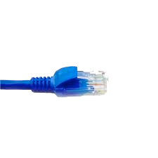
application
(www browser,
email client)
packet
analyzer
application
OS
packet
capture
(pcap)
Transport (TCP/UDP)
Network (IP)
Link (Ethernet)
Physical
copy of all Ethernet frames sent/received

Slide 35
Circuit vs Packet Switching
Internet Architecture

Slide 36
How to structure a network?
Question: given millions of access ISPs, how to connect them together?
…
…
access
net
access
net
access
net
access
net
access
net
access
net
access
net
…
…
access
net
access
net
access
net
access
net
access
net
access
net
…
access
net
access
net
…
access
net

Slide 37
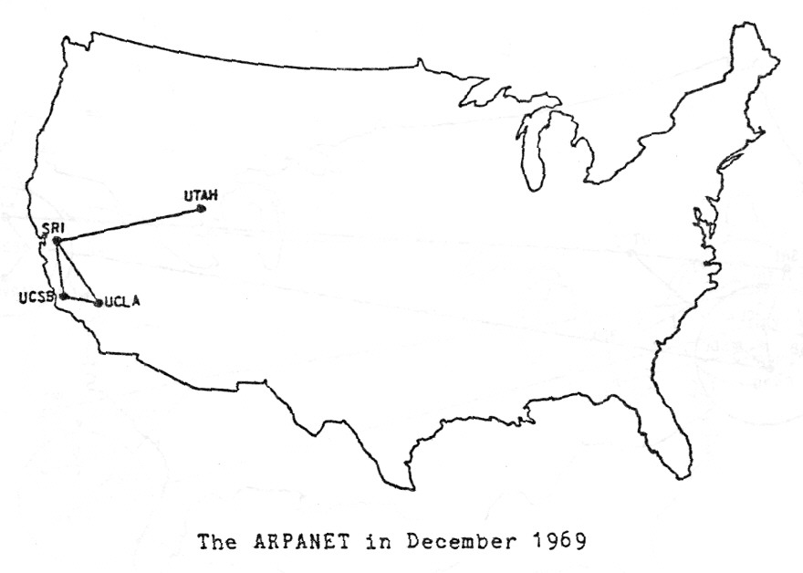
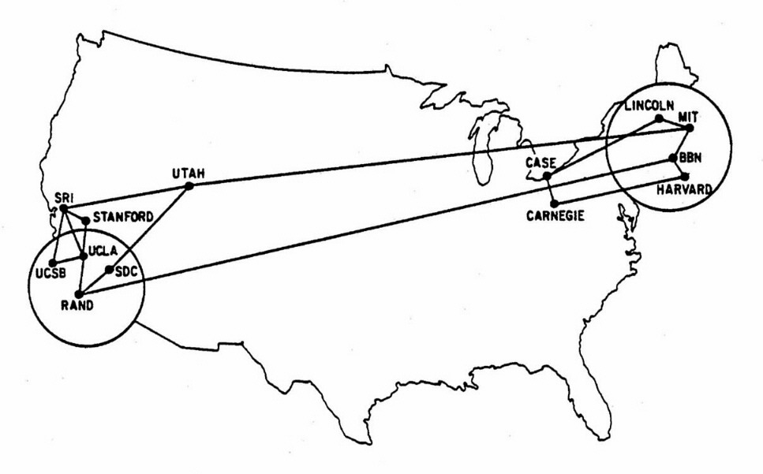
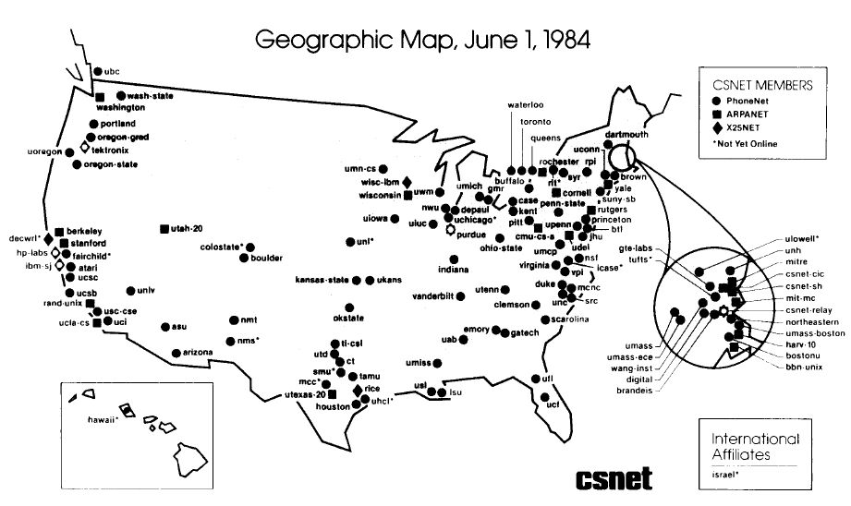
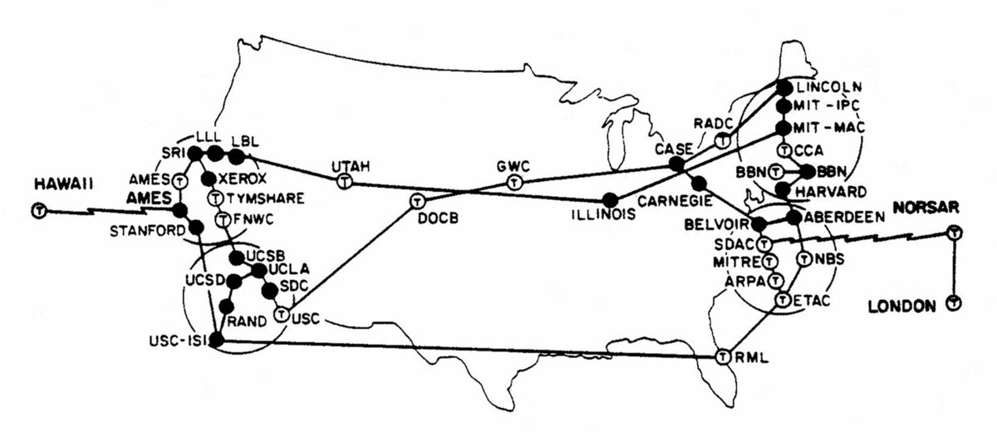
Internet: A Brief History
Maps from http://www.vox.com/a/internet-maps
1963: ARPANET
1970: ARPANET expands
1973: ARPANET goes international
1984: ARPANET becomes Internet

Slide 38
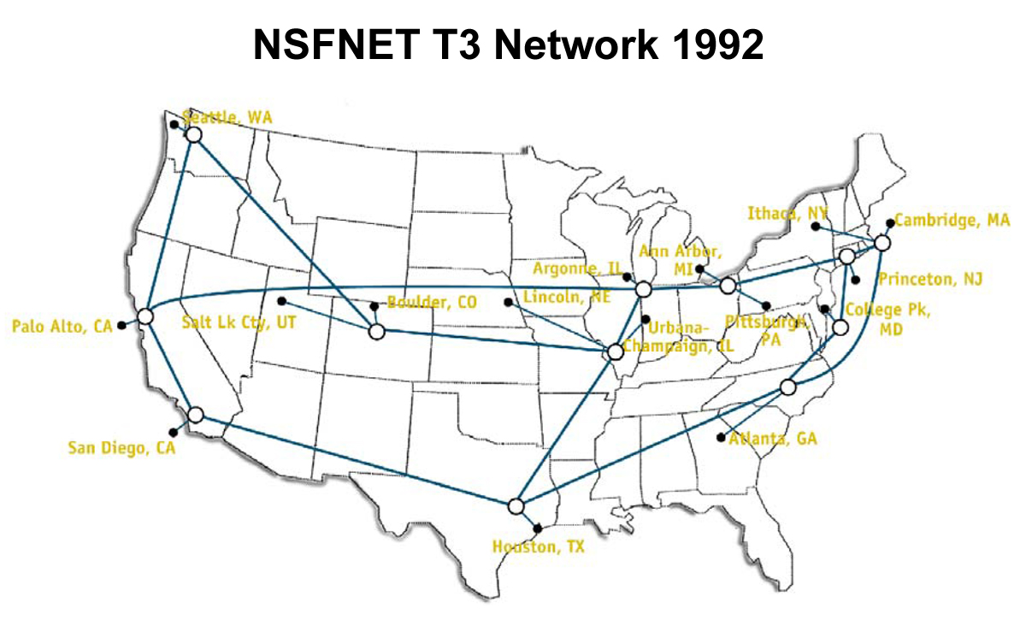
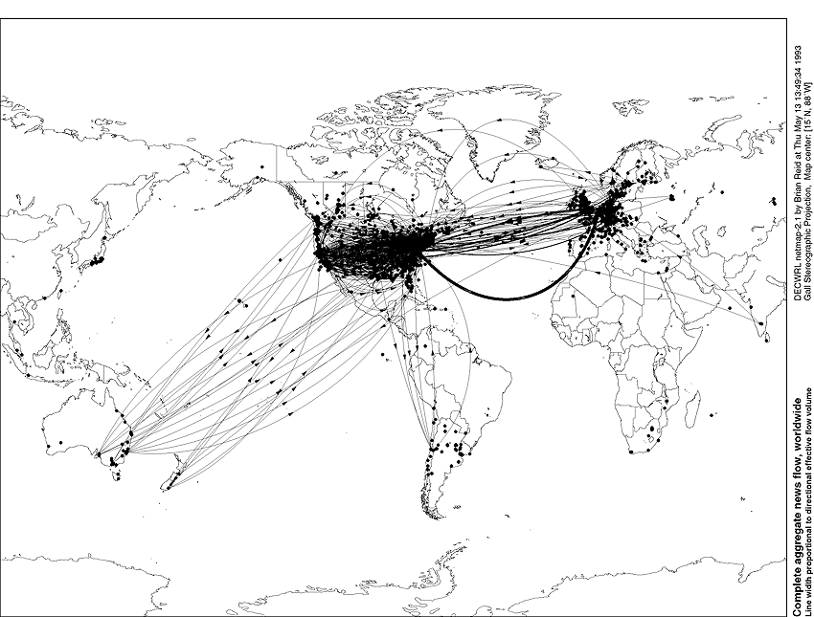
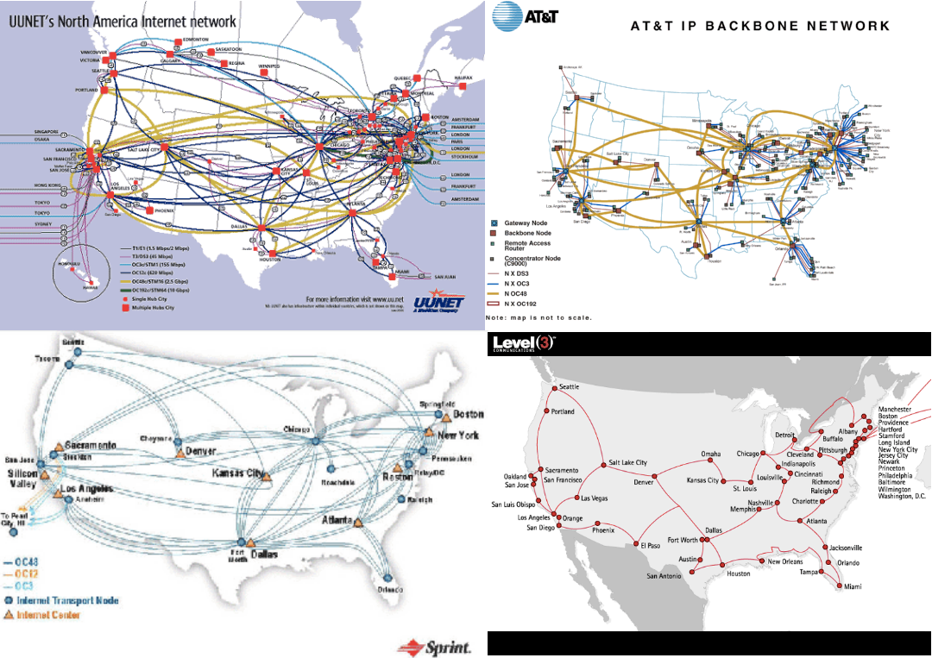
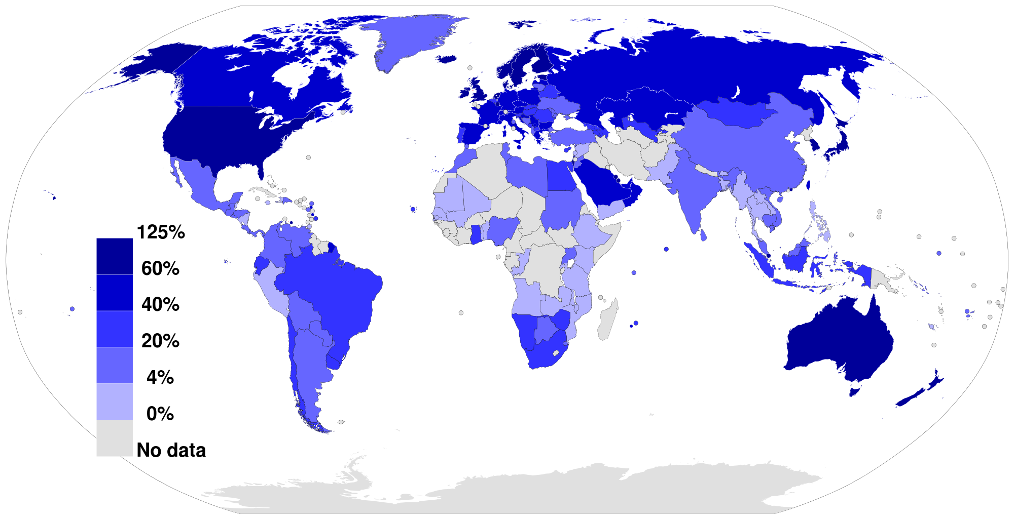
Internet: A Brief History
1992: NSFNET (backbone)
1993: The internet is global
1994: Privatization backbone
2012: Broadband penetration

Slide 39

Properties of Links
A
B
Capacity: “width” of the link
number of bits sent (or received) per unit time (bits/sec or bps)
Latency (delay): “length” of the link
propagation time for data to travel along the link (seconds)
Link rate: Peak achievable rates in practice
Capacity
Total bits in link
Latency

Slide 40
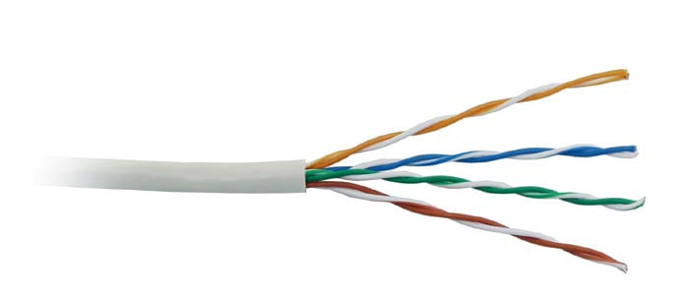
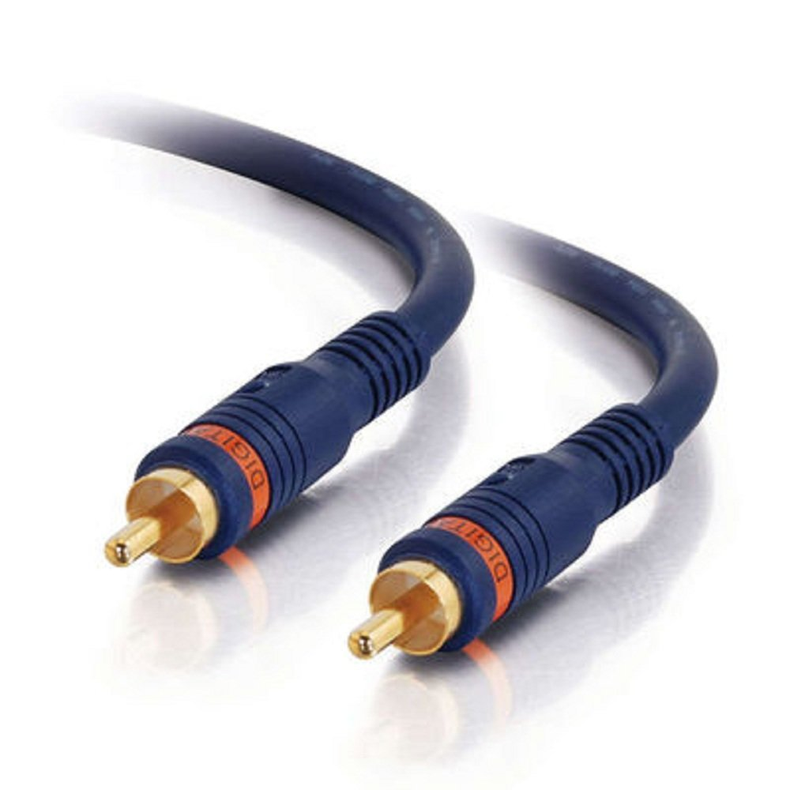
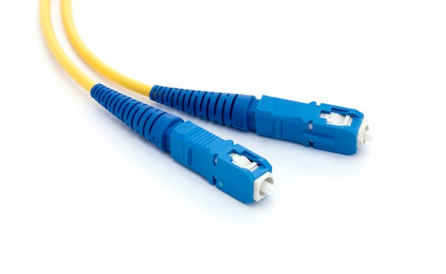
Example of Communication Media
Unshielded Twisted Pair (UTP)
Medium used in telephone line
Seven categories of increasing quality
Data rates from 0.1Mbps (CAT1) to 600Mbps (CAT6)
Coaxial cable
Audio/TV connectors
More resilient to external disturbances than UTP but more expensive, short distances
Data rates up to hundreds of Mbps
Fiber optic cable
Internet backbones
No external disturbance, small and inexpensive
Difficult interconnections, limited curvature
Data rates up to 10Gbps

Slide 41
Examples of Capacity-Delay
Propagation speed varies on the material, but it is roughly between 0.5 to 0.8 times the speed of light c, i.e., ~ 1.5x10⁸ msec
Same city over UTP:
Capacity~100Mbps
Latency~0.1msec (~15Km)
Total bits in link ~ 10,000bits ~ 1.25KBytes
Cross-country over fiber optic cable:
Capacity~10Gbps
Latency~10msec (~1500Km)
Total bits in link ~ 10⁸bits ~ 12.5GBytes

Slide 42
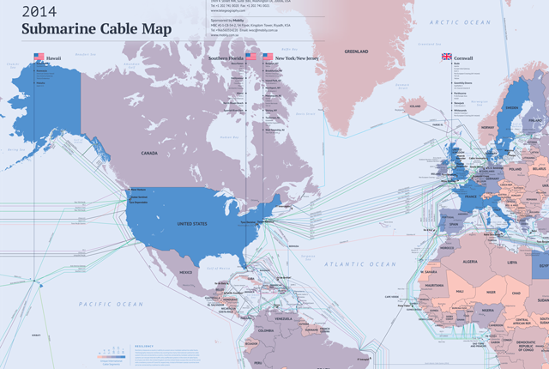
Internet Submarines Cables
More maps at http://www.submarinecablemap.com/

Slide 43
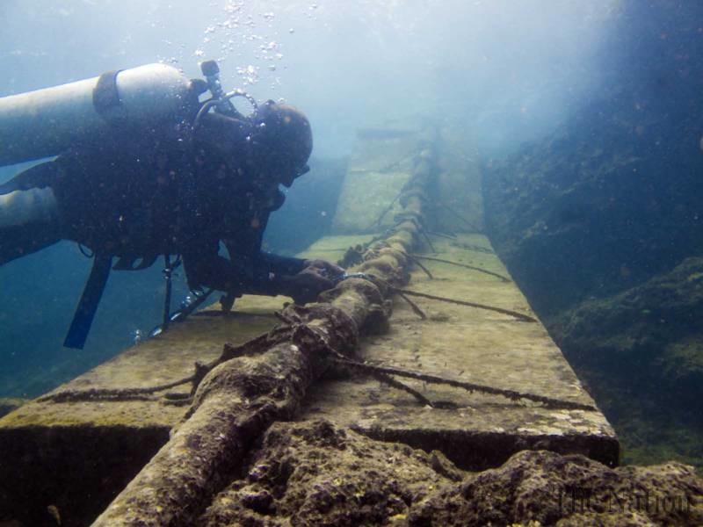
Internet Submarine cables
https://www.youtube.com/watch?feature=player_embedded&v=1ex7uTQf4bQ

Slide 44
Packet Delay Sending a 100B packet from A to B?
A
B
1Mbps, 1ms
100Byte packet
time=0
Time to transmit one bit = 1/10⁶s
Time when that bit reaches B = 1/10⁶+1/10³s
Time to transmit 800 bits=800x1/10⁶s
The last bit reaches B at
(800x1/10⁶)+1/10³s
= 1.8ms
Packet Delay = Transmission Delay + Propagation Delay
Packet Delay =
(Packet Size ÷ Link Capacity) + Link Latency
Time

Slide 45
Packet Delay Sending a 100B packet from A to B?
1GB file in 100B packets
1Gbps, 1ms?
A
B
1Mbps, 1ms
100Byte packet
10⁷ x 100B packets
The last bit in the file reaches B at
(10⁷x800x1/10⁹)+1/10³s
= 8001ms
The last bit reaches B at
(800x1/10⁹)+1/10³s
= 1.0008ms
The last bit reaches B at
(800x1/10⁶)+1/10³s
= 1.8ms
Time

Slide 46
Packet Delay: The “pipe” view Sending 100B packets from A to B?
A
B
100Byte packet
1Mbps, 10ms
pkt tx time
100Byte packet
100Byte packet
BW →
time →
Time

Slide 47
What if we have more nodes?
One link for every node?
Need a scalable way to interconnect nodes

Slide 48
Switching Network
Notes:
multiple conversations in parallel
resources are shared

Slide 49
Solution: A switched network
Nodes share network link resources
How is this sharing implemented?
Notes:
multiple conversations in parallel
resources are shared

Slide 50
Circuit switching
Idea: source reserves network capacity along a path
10Mb/s?
B
A
10Mb/s?
10Mb/s?
(1) Node A sends a reservation request
(2) Interior switches establish a connection -- i.e., “circuit”
(3) A starts sending data
(4) A sends a “teardown circuit” message
Notes:
multiple conversations in parallel
resources are shared

Slide 51
Circuit Switching: Sharing a Link
Time-division
Each circuit allocated certain time slots
Frequency-division
Each circuit allocated certain frequencies
frequency
time
time

Slide 52
Time-Division Multiplexing
Frames
Slots =
0
1
2
3
4
5
0
1
2
3
4
5
Time divided into frames; frames into slots
Relative slot position inside a frame determines to which conversation data belongs
e.g., slot 0 belongs to orange conversation
Slots are reserved (released) during circuit setup (teardown)
If a conversation does not use its circuit capacity is lost!

Slide 53
Timing in Circuit Switching
time

Slide 54
Timing in Circuit Switching
time

Slide 55
Timing in Circuit Switching
time

Slide 56
Timing in Circuit Switching
time

Slide 57
Timing in Circuit Switching
Circuit Establishment
time

Slide 58
Timing in Circuit Switching
Information
Circuit Establishment
Transfer
time

Slide 59
Timing in Circuit Switching
Information
Circuit Establishment
Transfer
time
Circuit Teardown
Notes:
Why the delays in the first pass of the establishment, but not in subsequent passes (or in teardown)?

Slide 60
Circuit switching: pros and cons
Pros
guaranteed performance
fast transfer (once circuit is established)
Cons

Slide 61
Timing in Circuit Switching
Information
Circuit Establishment
Transfer
time
Circuit Teardown
Notes:
Why the delays in the first pass of the establishment, but not in subsequent passes (or in teardown)?

Slide 62
Circuit switching: pros and cons
Pros
guaranteed performance
fast transfer (once circuit is established)
Cons
wastes capacity if traffic is “bursty”

Slide 63
Timing in Circuit Switching
Information
Circuit Establishment
Transfer
time
Circuit Teardown
Notes:
Why the delays in the first pass of the establishment, but not in subsequent passes (or in teardown)?

Slide 64
Timing in Circuit Switching
Information
Circuit Establishment
Data transfer
Circuit Teardown
time
Notes:
Why the delays in the first pass of the establishment, but not in subsequent passes (or in teardown)?

Slide 65
Circuit switching: pros and cons
Pros
guaranteed performance
fast transfers (once circuit is established)
Cons
wastes capacity if traffic is “bursty”
connection setup time is overhead

Slide 66
Circuit switching
A
B
Circuit switching doesn’t “route around trouble”
Notes:
multiple conversations in parallel
resources are shared

Slide 67
Circuit switching: pros and cons
Pros
guaranteed performance
fast transfers (once circuit is established)
Cons
wastes capacity if traffic is “bursty”
connection setup time is overhead
recovery from failure is slow

Slide 68
Circuit switching: pros and cons
Pros
guaranteed performance
fast transfers (once circuit is established)
Cons
wastes capacity if traffic is “bursty”
connection setup adds delay
recovery from failure is slow
[in the telephone network] designed for a specific app

Slide 69
Packet switching

Slide 70

Packet Switching
Data is sent as chunks of formatted bits (Packets)
Packets consist of a “header” and “payload”
Data is sent as chunks of formatted bits (Packets)
Packets consist of a “header” and “payload”
Switches “forward” packets based on their headers
Each packet travels independently
no notion of packets belonging to a “circuit”
No link resources are reserved in advance. Instead packet switching leverages statistical multiplexing
Header
Data
header
payload
01000111100010101001110100011001

Slide 71
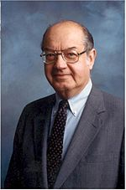
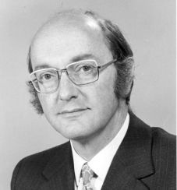

Inventors of Packet Switching
Paul Baran
Donald Davies
Leonard Kleinrock
Watch the following interview with Prof. Kleinrock for a historical perspective:
https://www.youtube.com/watch?v=qsgrtrwydjw

Slide 72
Timing in Packet Switching
payload
hdr
time
What about the time to process the packet at the switch?
We’ll assume it’s relatively negligible (mostly true)
Notes:
Why the delays in the first pass of the establishment, but not in subsequent passes (or in teardown)?

Slide 73
Timing in Packet Switching
payload
hdr
Could the switch start transmitting as soon as it has processed the header?
time
Yes! This would be called a “cut through” switch
Notes:
Why the delays in the first pass of the establishment, but not in subsequent passes (or in teardown)?

Slide 74
Timing in Packet Switching
payload
hdr
We will always assume a switch processes/forwards a packet after it has received it entirely. This is called “store and forward” switching
time
Notes:
Why the delays in the first pass of the establishment, but not in subsequent passes (or in teardown)?

Slide 75
Statistical Multiplexing

Slide 76

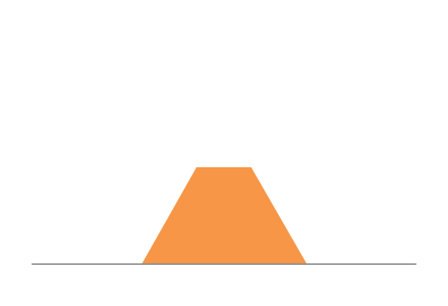
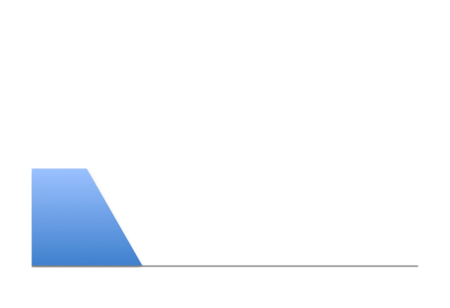
Three Flows with Bursty Traffic
Data Rate 1
Time
Data Rate 2
Capacity
Time
Data Rate 3
Time

Slide 77
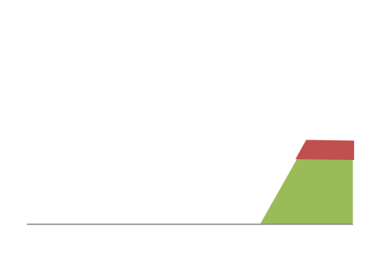
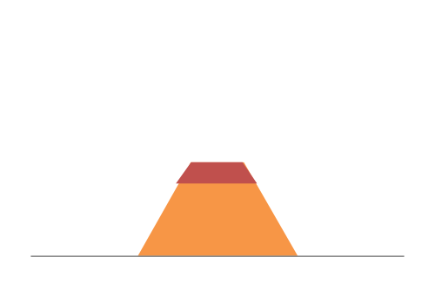
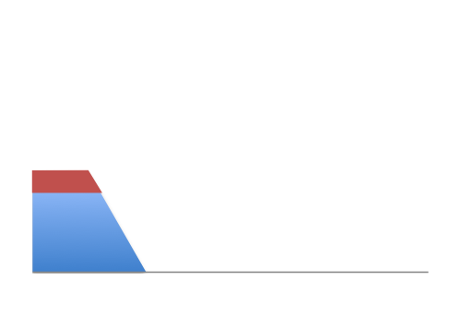
When Each Flow Gets 1/3rd of Capacity
Frequent Overloading
Data Rate 1
Time
Data Rate 2
Time
Data Rate 3
Time

Slide 78
When Flows Share Total Capacity
Time
No Overloading
Time
Statistical multiplexing relies on the assumption
that not all flows burst at the same time.
Very similar to insurance, and has same failure case
Time

Slide 79
Three Flows with Bursty Traffic
Data Rate 1
Time
Data Rate 2
Capacity
Time
Data Rate 3
Time

Slide 80

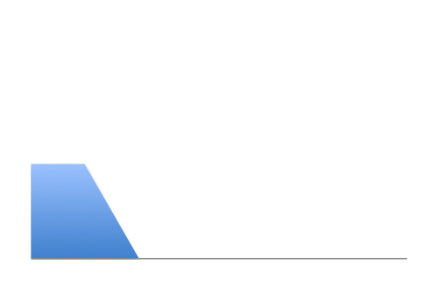
Three Flows with Bursty Traffic
Data Rate 1
Time
Data Rate 2
Capacity
Time
Data Rate 3
Time

Slide 81


Three Flows with Bursty Traffic
Data Rate 1+2+3 >> Capacity
Time
Capacity
Time
What do we do under overload?

Slide 82

Statistical multiplexing: pipe view
pkt tx time
BW →
time →

Slide 83
Statistical multiplexing: pipe view

Slide 84
Statistical multiplexing: pipe view
No Overload!

Slide 85
Statistical multiplexing: pipe view
Queue
Transient Overload
Not a rare event!

Slide 86
Statistical multiplexing: pipe view
Queue
Transient Overload
Not a rare event!

Slide 87
Statistical multiplexing: pipe view
Queue
Transient Overload
Not a rare event!

Slide 88
Statistical multiplexing: pipe view
Queue
Transient Overload
Not a rare event!

Slide 89
Statistical multiplexing: pipe view
Queue
Transient Overload
Not a rare event!

Slide 90
Statistical multiplexing: pipe view
Queue
Transient Overload
Queues absorb transient bursts!
Not a rare event!

Slide 91
Statistical multiplexing: pipe view
What about persistent overload?
Will eventually drop packets

Slide 92
Queues introduce queuing delays
Recall, packet delay = tx delay + prop delay
With queues (stat. muxing)
packet delay = tx delay + prop delay + queuing delay
Queuing delay caused by “packet interference”
Made worse at high load
less “idle time” to absorb bursts
think about traffic jams at rush hour

Slide 93
Circuit switching: pros and cons
Pros
guaranteed performance
fast transfers (once circuit is established)
Cons
wastes capacity if traffic is “bursty”
connection setup adds delay
recovery from failure is slow

Slide 94
Packet switching: pros and cons
Cons
no guaranteed performance
header overhead per packet
queues and queuing delays
Pros
efficient use of capacity (stat. muxing)
no overhead due to connection setup
resilient -- can `route around trouble’

Slide 95
The Internet Protocol Stack?
Internet Architecture

Slide 96
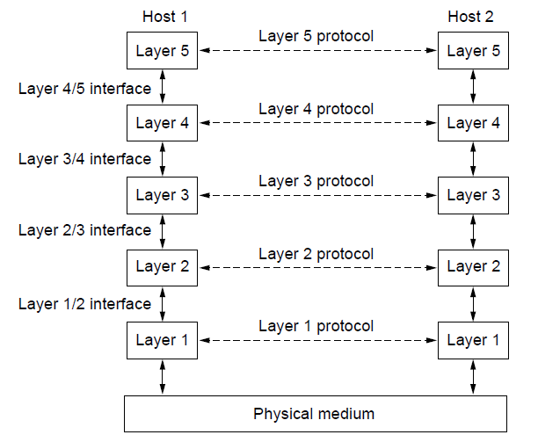
Protocol Layers as an Architecture
Protocol layering is the main structuring method used to divide up network functionality.
Each protocol instance talks virtually to its peer
Each layer communicates only by using the one below
Lower layer services are accessed by an interface
At bottom, messages are carried by the medium

Slide 97
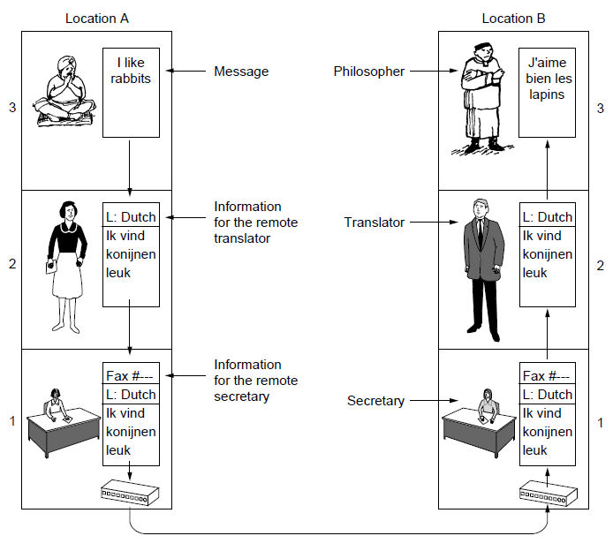
Protocol Layers: An Example
Example: the philosopher-translator-secretary architecture
Each protocol at different layers serves a different purpose

Slide 98
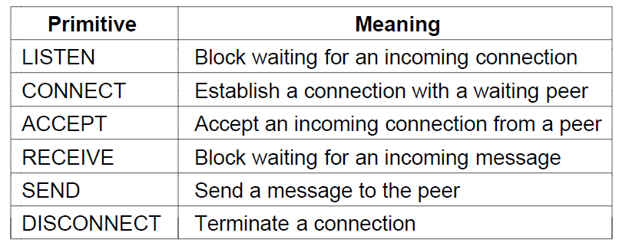
Service Primitives (1)
A service is provided to the layer above as primitives
Hypothetical example of service primitives that may provide a reliable byte stream (connection-oriented) service:

Slide 99
Service Primitives (2)
Hypothetical example of how these primitives may be used for a client-server interaction
Client
Server
LISTEN (0)
CONNECT (1)
Connect request
ACCEPT
(2)
Accept response
RECEIVE
SEND
Request for data
(3)
RECEIVE
SEND (4)
Reply
DISCONNECT (5)
Disconnect
DISCONNECT (6)
Disconnect
Notes:
The primitives are called at the client and server by the higher layer using the service. The layer implements the primitives by sending messages using the services of the lower layer; these messages are assumed to be reliable for simplicity and the lower layer service is not otherwise described.
This is similar to the way that simple Web browsers and Web servers work today.

Slide 100
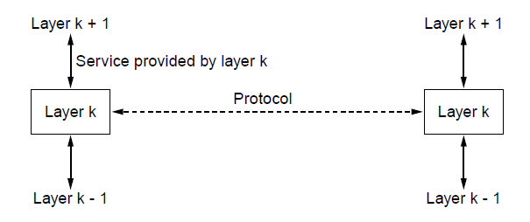
Relationship of Services to Protocols
Recap:
A layer provides a service to the one above [vertical]
A layer talks to its peer using a protocol [horizontal]

Slide 101
Protocol Layers as an Architecture
Protocol layering is the main structuring method used to divide up network functionality.
Each protocol instance talks virtually to its peer
Each layer communicates only by using the one below
Lower layer services are accessed by an interface
At bottom, messages are carried by the medium
This view assumes a network consists of hosts only.
Reasons to build infra-structure (simpler nodes than full fledge hosts)…

Slide 102
Switching Network
Notes:
multiple conversations in parallel
resources are shared

Slide 103

Routers Forward Packets
Routers determine the next hop for a packet based on the destination IP address
Routing algorithms ensure packets follow the shortest path from source to destination
Each router constantly update a routing table specifying the next hop for each destination address
to 169.229.60.32
switch#4
switch#2
Routing Table
Destination | Next Hop
169.229.60.1 | 4
16.129.123.1 | 5
169.229.60.32 | 2
110.19.116.102 | 3
111010010
169.229.60.32
switch#5
switch#3

Slide 104
Open System Interconnection (OSI)
Conceptual model of the International Organization for Standardization (ISO)
Each layer accomplishes different tasks
Well defined interfaces across layers
Layers interacts with peer’s corresponding layer
Application
Application
Transport
Transport
Network
Network
Network
Datalink
Datalink
Datalink
Physical
Physical
Physical
Host A
Router
Host B

Slide 105
Open System Interconnection (OSI)
Lower two layers implemented in all network devices (routers have 3 layers, switches 2)
Top two layers implemented only at hosts
Communication goes down to physical network
Then up to relevant layer
Application
Application
Transport
Transport
Network
Network
Network
Datalink
Datalink
Datalink
Physical
Physical
Physical
Host A
Router
Host B

Slide 106
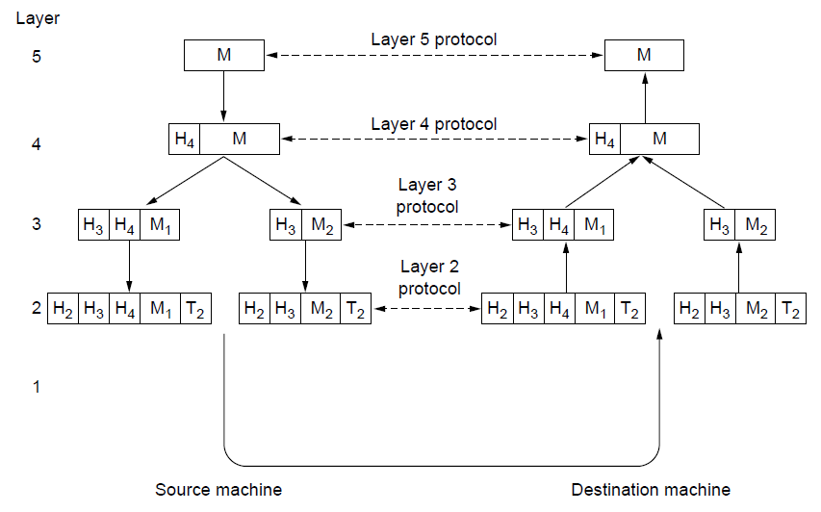
Protocol Layer: Encapsulation
Each lower layer adds its own header (with control information) to the message to transmit and removes it on receive
Layers split and join messages, etc.
Common case: 20 bytes TCP header + 20 bytes IP header + 14 bytes Ethernet header = 54 bytes overhead

Slide 107
Example: HTTP Connection
host
host
HTTP message
HTTP
HTTP
TCP segment
TCP
TCP
router
router
IP
IP packet
IP packet
IP packet
IP
IP
IP
Ethernet
interface
Ethernet
interface
SONET
interface
SONET
interface
Ethernet
interface
Ethernet
interface
107

Slide 108
Layers/Encapsulation in HTTP
User A
User B
Application
Get index.html
App-to-app
channels
Connection ID
Host-to-host
connectivity
Source/Destination
Link hardware
Link Address

Slide 109

Internet Protocol Layers
application layer
application layer
User Process
User Process
Socket
Socket
transport layer (TCP/UDP)
transport layer (TCP/UDP)
network layer (IP)
network layer (IP)
link layer (e.g. ethernet)
Internet
link layer (e.g. ethernet)

Slide 110
End Host vs. Core (Switch vs. Router)
source
message
M
application
transport
network
link
physical
segment
H_{t}
M
H_{t}
datagram
H_{n}
H_{n}
H_{t}
M
frame
H_{l}
H_{n}
H_{t}
M
H_{l}
H_{n}
H_{t}
M
link
physical
switch
destination
H_{n}
H_{t}
M
network
link
physical
M
application
transport
network
link
physical
H_{l}
H_{n}
H_{t}
M
H_{t}
M
H_{n}
H_{t}
M
H_{l}
H_{n}
H_{t}
M
router

Slide 111
Switch vs. Router
source
Switch and Router have similar functionality:
Redirecting packets from input to output (lookup table)
Complexity grows with size
Switches are designed for local and small-scale operation (link layer)
Routers are designed to handle large scales (network layer)
EXCEPTION: multilayer (l3) switch
message
M
application
transport
network
link
physical
segment
H_{t}
M
H_{t}
datagram
H_{n}
H_{n}
H_{t}
M
frame
H_{l}
H_{n}
H_{t}
M
link
physical
switch
destination
H_{n}
H_{t}
M
network
link
physical
M
application
transport
network
link
physical
H_{l}
H_{n}
H_{t}
M
H_{t}
M
H_{n}
H_{t}
M
H_{l}
H_{n}
H_{t}
M
router

Slide 112
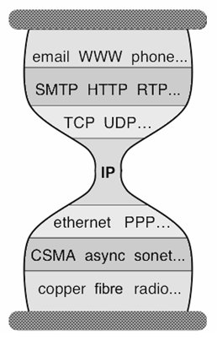
Error, Flow, and Congestion Control
Applications
…built on…
Reliable (or unreliable) transport
…built on…
Best-effort global packet delivery
…built on…
Best-effort local packet delivery
…built on…
Physical transfer of bits
Digital data is translated into electronic/optical signals and transmitted
This is the job of physical layer --below link layer– and mostly beyond the scope of 158A (ECE154/157 series, ECE159)

